Slide 1
A & P
Anatomy & Physiology

Slide 2
Anatomy versus Physiology
How the body is made
How the body works
Notes:
Talking Points
Anatomy refers to the structure of the body and the relationship of its parts to each other (how the body is made).
Physiology refers to the function of the living body and its parts (how the body works).
Point to Emphasize
Anatomy is the study of structure. Physiology is the study of function.
2

Slide 3
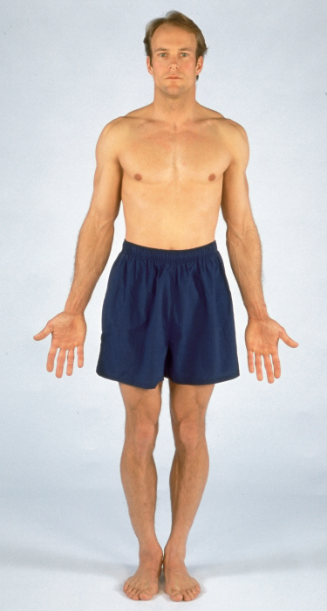
Topographic Anatomy
Superficial landmarks
  Serve as guides to structures
  that lie beneath them
Topographic anatomy applies
to a body in the anatomic
position.
  Patient stands facing you,
  arms at side, palms forward.

Slide 4
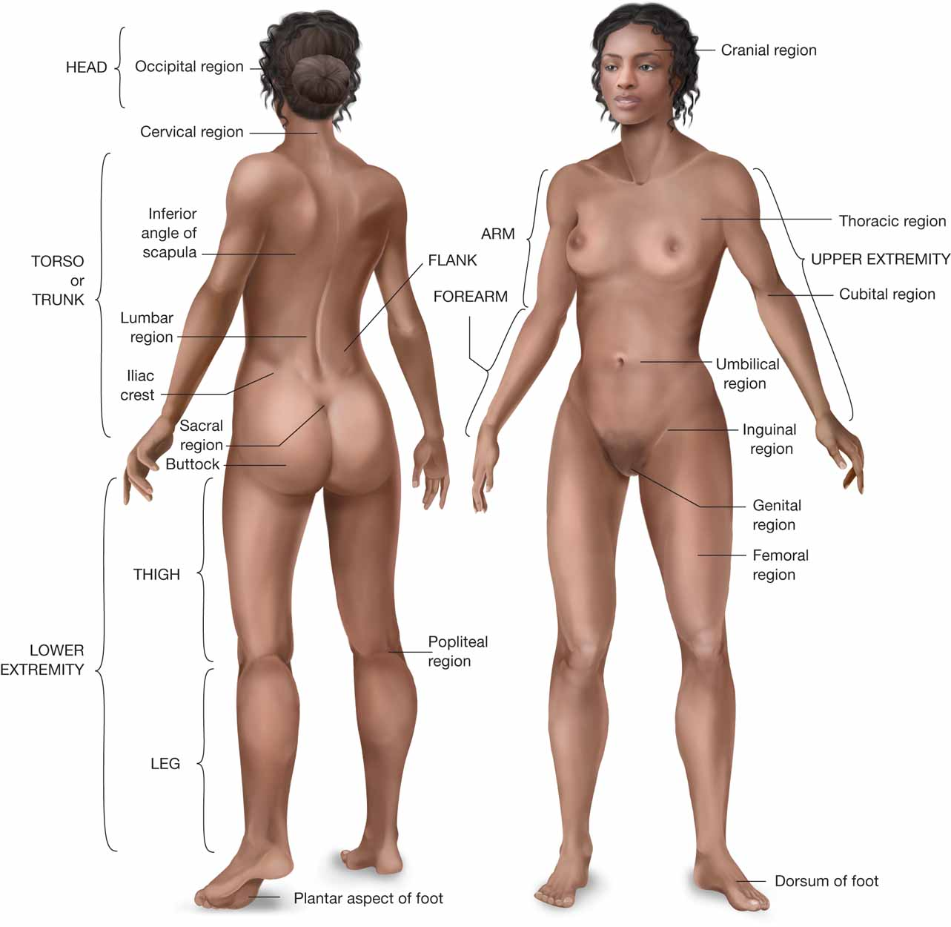
Regions of the body

Slide 5
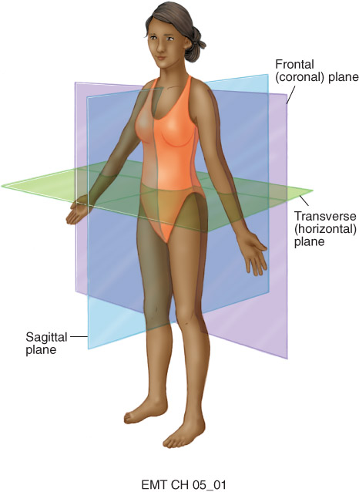
Planes of the Body
Imaginary straight lines that divide the body
Three main areas
  Coronal plane: front/back
  Transverse (axial) plane: top/bottom
  Sagittal (lateral) plane: left/right

Slide 6
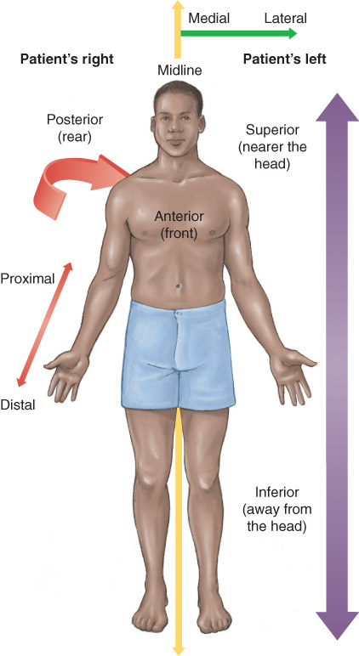
Directional Terms
Midline: vertically through the middle of the patient’s body
Medial is toward the midline
Lateral is away from the
midline.
Proximal is near a point of reference
Distal is away from the reference
Palmar refers to palms of the hand.
Plantar refers to sole of the feet
Palmar
Plantar

Slide 7
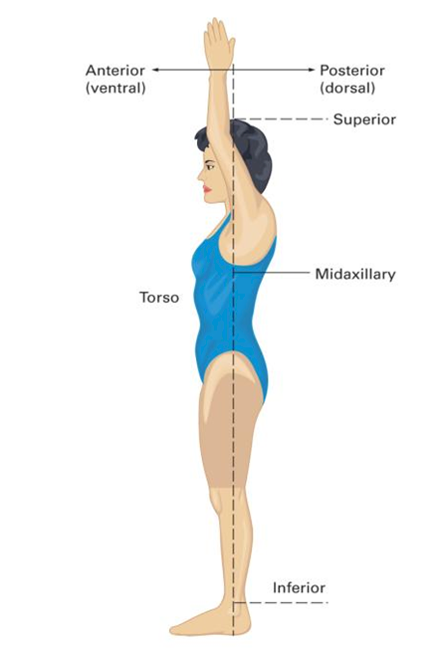
Anatomical Planes
Midaxillary Line divides the body into anterior and posterior planes
Anterior is toward the front
Posterior is toward the back.
Superior is above, toward the head
Inferior is below, toward the feet.
Dorsal is toward the back/spine
Ventral is toward the front/belly.
Notes:
Talking Points
The sagittal plane is vertical and drawn front to back, dividing the body into right and left planes.
The frontal plane divides the body into front and back halves.
The transverse plane divides the body into upper and lower halves.
The midline is an imaginary line drawn vertically through the middle of the patient’s body, dividing it into right and left planes.
Anterior is toward the front and posterior is toward the back.
Superior is above, toward the head and inferior is below, toward the feet.
Dorsal is toward the back/spine and ventral is toward the front/belly.
Medial is toward the midline and lateral is away from the midline.
Proximal is near a point of reference and distal is away from the reference.
Plantar refers to sole of the feet and palmar refers to palms of the hand.
Teaching Tip
Ask students to use the terms above to describe the relationship of various body parts to each other, such as the ankle, knee, wrist, elbow, and shoulder.
Discussion Question
How is anterior and posterior related to ventral and dorsal?

Slide 8
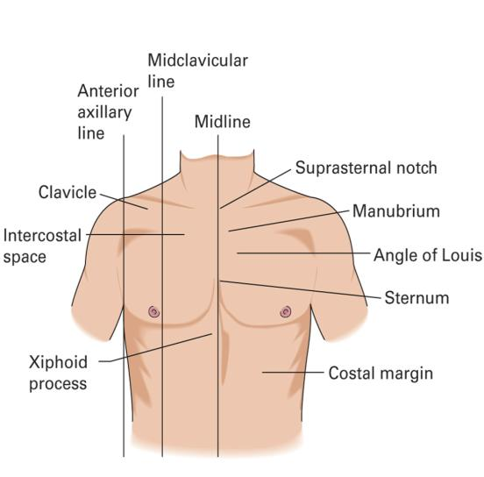
Chest Landmarks
Notes:
Talking Points
The midaxillary line is an imaginary line that divides the body into anterior and posterior planes. The imaginary line is from the middle of the armpit to the ankle. Midaxillary refers to the center of the armpit (axilla).
Midclavicular refers to the center of each of the collarbones (clavicle). The midclavicular line extends from the center of either collarbone down the anterior thorax.
Class Activity
Divide students into pairs. Give each pair a length of masking or adhesive tape that students will tear into smaller pieces during the exercise. During the exercise, two pairs of students at a time will come to the front of the class. The first pair will turn their backs so they cannot see the second pair. One of the second pair will place a piece of tape somewhere on his partner. The class will describe to the first pair, using anatomical and directional terms, the location of the tape. For example, “Two inches inferior to the right elbow, on the posterior aspect.” Without looking, one of the first pair will try to place a piece of tape in the location described by the class.
8

Slide 9
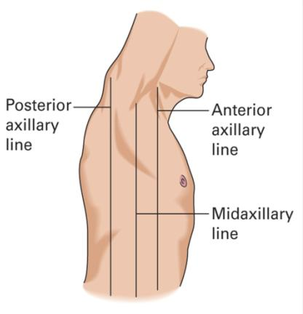
Chest Landmarks
Notes:
Talking Points
The midaxillary line is an imaginary line that divides the body into anterior and posterior planes. The imaginary line is from the middle of the armpit to the ankle. Midaxillary refers to the center of the armpit (axilla).
Midclavicular refers to the center of each of the collarbones (clavicle). The midclavicular line extends from the center of either collarbone down the anterior thorax.
Class Activity
Divide students into pairs. Give each pair a length of masking or adhesive tape that students will tear into smaller pieces during the exercise. During the exercise, two pairs of students at a time will come to the front of the class. The first pair will turn their backs so they cannot see the second pair. One of the second pair will place a piece of tape somewhere on his partner. The class will describe to the first pair, using anatomical and directional terms, the location of the tape. For example, “Two inches inferior to the right elbow, on the posterior aspect.” Without looking, one of the first pair will try to place a piece of tape in the location described by the class.

Slide 10
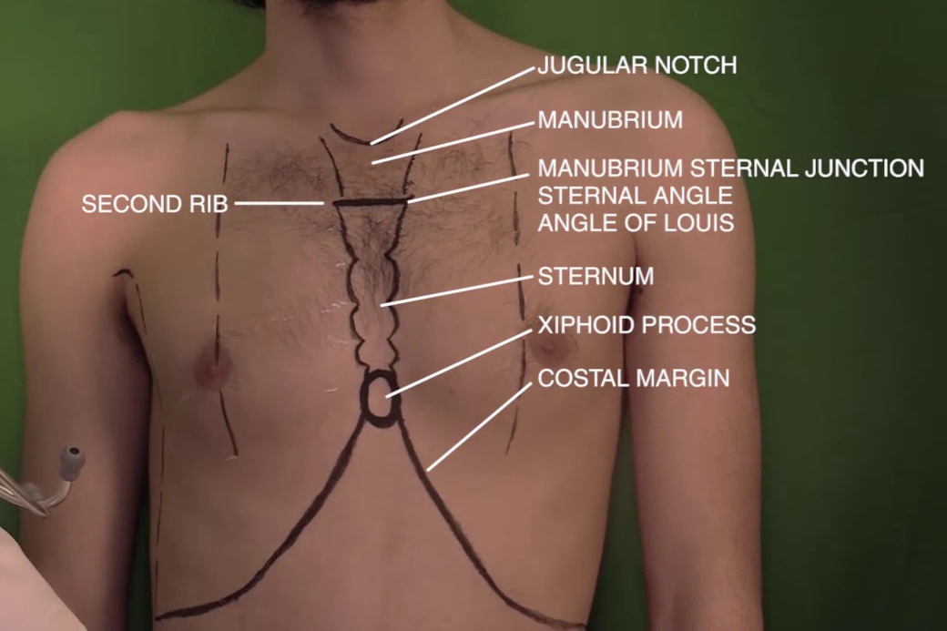
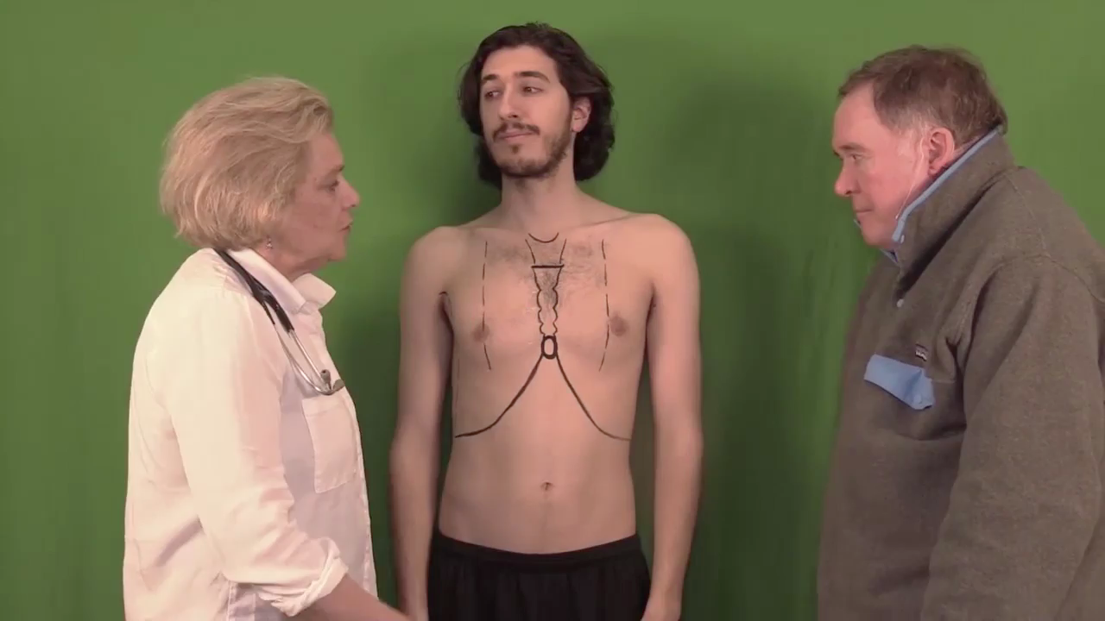

Slide 11
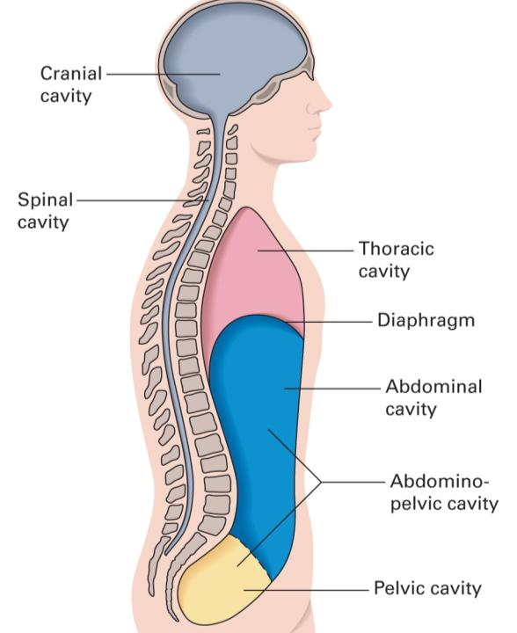
Body Cavities
Notes:
Talking Points
The brain and spinal cord are contained within the cranial and spinal cavities.
The diaphragm separates the thoracic and abdominal cavities.
There is no physical separation of the abdominal and pelvic cavities.
Critical Thinking Discussion
What are the pros and cons of using anatomical terms of position and direction?
Why is it important for EMTs to understand this terminology?
11

Slide 12
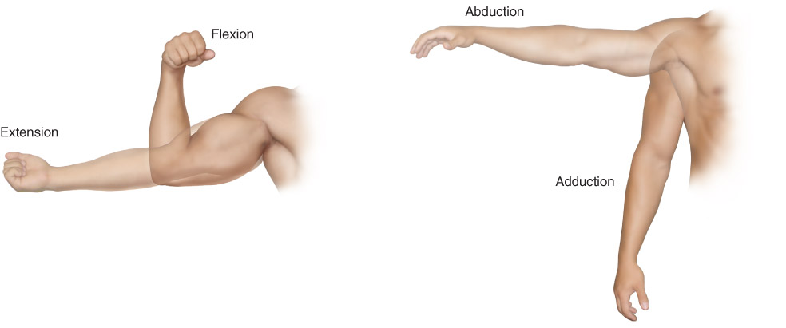
Movement Terms
Flexion is the bending of a joint.
Extension is the straightening of a joint.
Adduction is motion toward the midline.
Abduction is motion away from the midline.

Slide 13
Other Directional Terms
Bilateral structures, appear on both sides of midline.
  Eyes
  Lungs
  Arms & Legs
Abdomen is divided into quadrants for communication purposes.
  RUQ (Right Upper Quadrant)
  LUQ (Left Upper Quadrant)
  RLQ (Right Lower Quadrant)
  LLQ (Left Lower Quadrant)

Slide 14
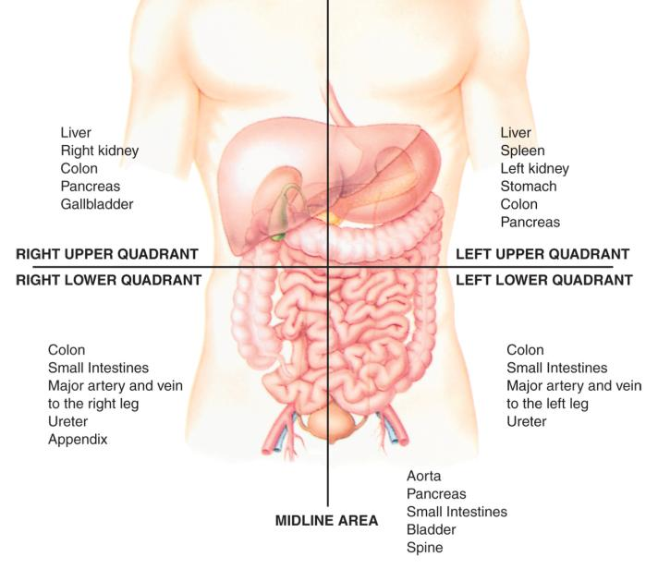
Abdominal Organs
Notes:
Talking Points
The four abdominal quadrants are:
Right upper quadrant (RUQ)
Right lower quadrant (RLQ)
Left upper quadrant (LUQ)
Left lower quadrant (LLQ)
Point to Emphasize
The location of abdominal organs can be approximated by drawing imaginary quadrants with lines that intersect at the umbilicus (navel).
Knowledge Application
Point to several locations on your body. Have students describe the locations using anatomical terms.
14

Slide 15
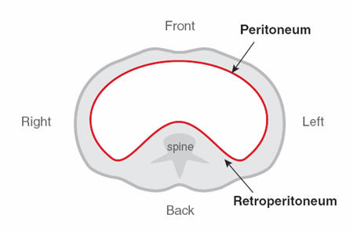
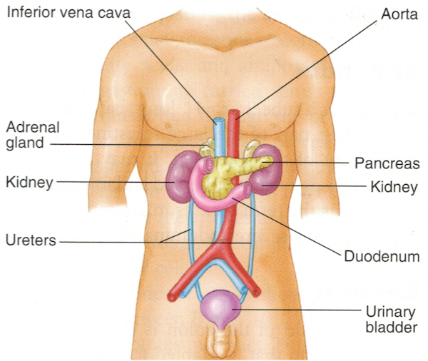
Abdominal Organs In the Retroperitoneal space

Slide 16
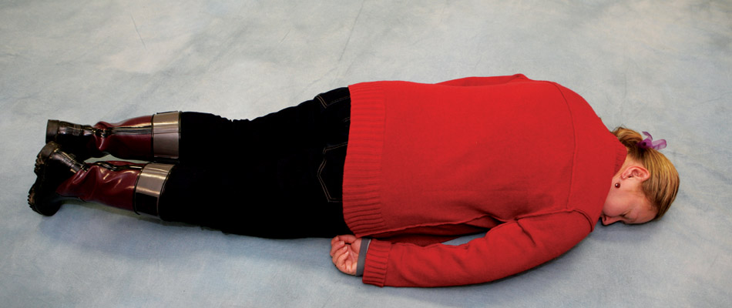
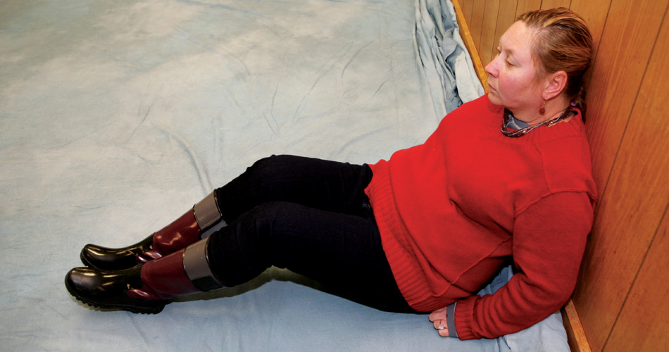
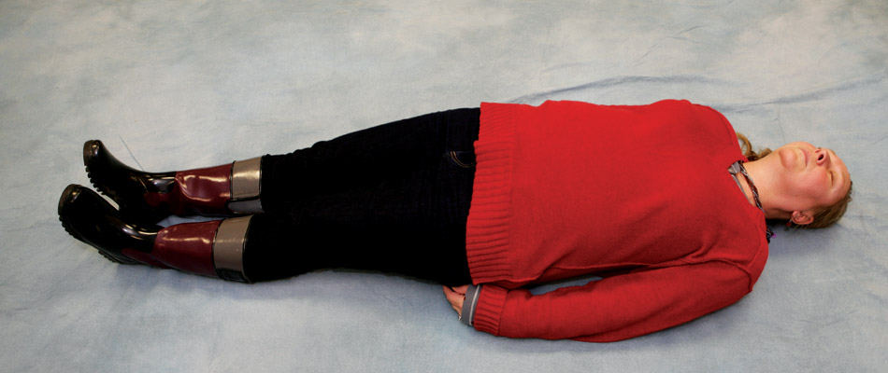
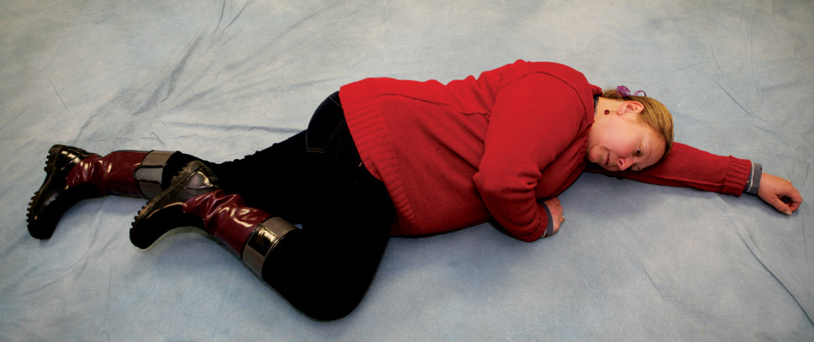
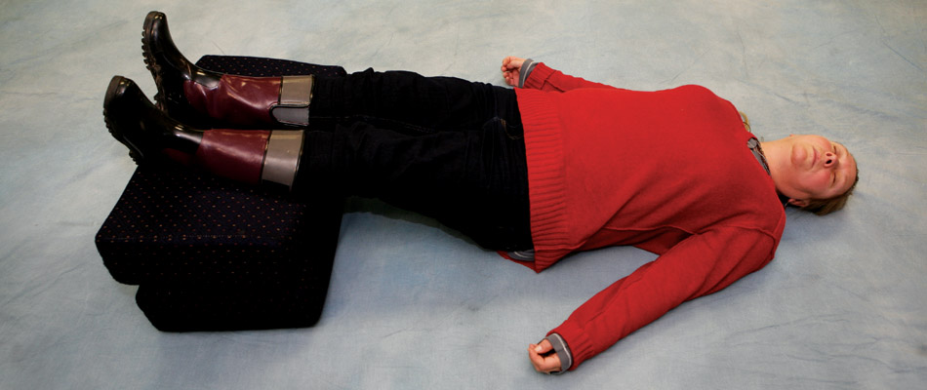
Anatomic Positions
Fowler
Prone
Recovery
Supine
Shock

Slide 17
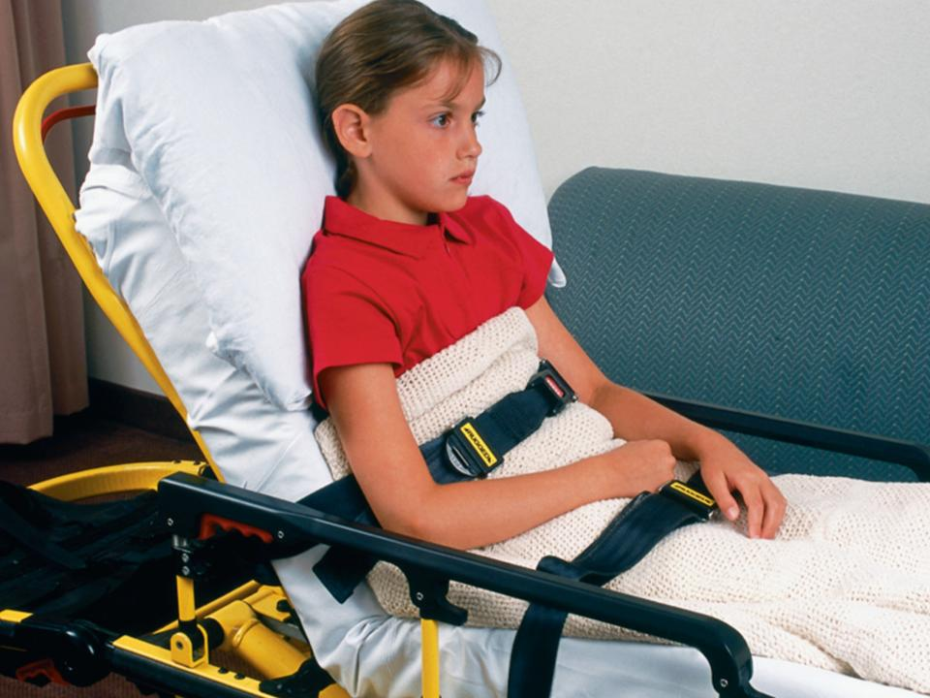
Fowler
Semi-Fowler
45°to 60°
<45°
Notes:
Talking Points
Fowler’s position: The patient is lying on his back with his upper body elevated at a 45- to 60-degree angle.
Semi-Fowler’s position: The patient is lying on his back with the upper body elevated at an angle less than 45 degrees.
Knowledge Application
Upon hearing “plain English” descriptions of patient positions, students will substitute the anatomically correct term.
17

Slide 18
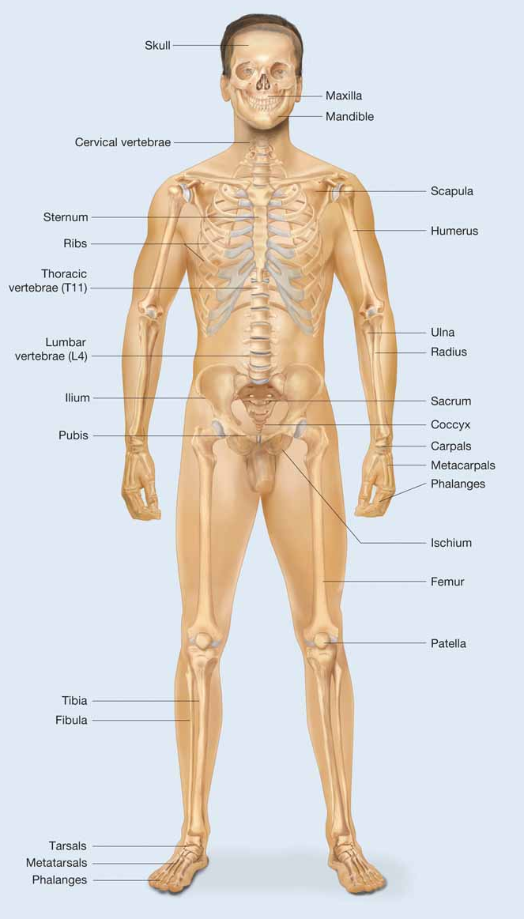
The Skeletal
System: Anatomy
Skeleton gives us our recognizable human form.
Protects vital internal organs
Contains
  Bones
  Ligaments
  Tendons
  Cartilage

Slide 19
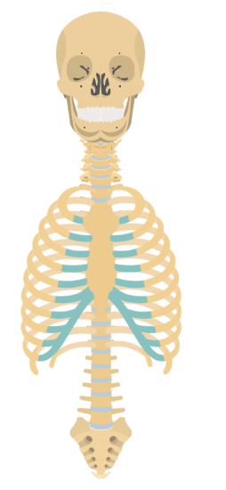
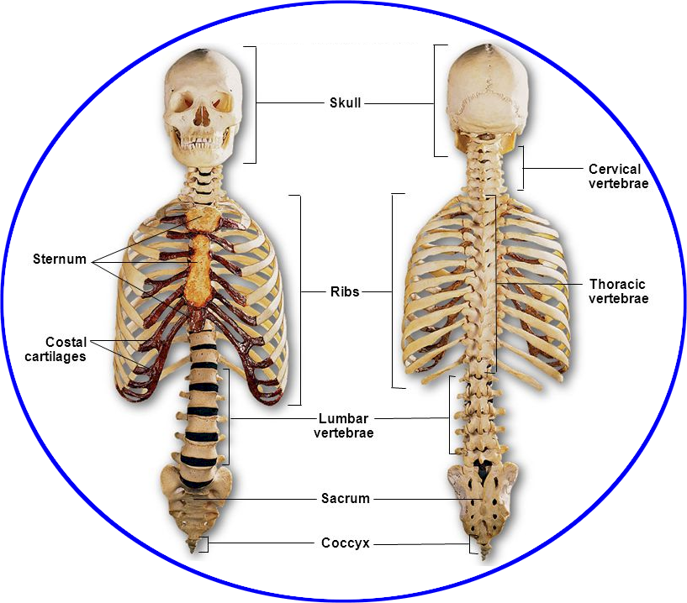
The Axial Skeleton
The axial skeleton is the foundation to which the arms and legs are attached.
It includes:
  Skull
  Spinal column
  Thorax
Notes:
Lecture Outline
D. The skeletal system is divided into two portions: the axial skeleton and the appendicular skeleton.
1. Axial skeleton: foundation to which the arms and legs are attached

Slide 20
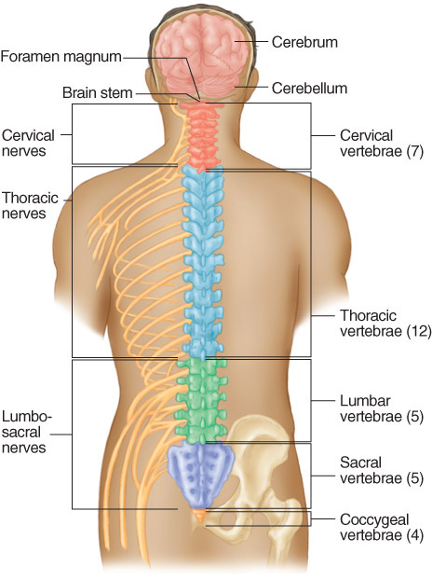
Spinal column
Composed of 33
bones (vertebrae)
Spine divided into
5 sections:
  Cervical
  Thoracic
  Lumbar
  Sacrum
  Coccyx
(7)
(12)
(5)
(5)
(4)

Slide 21
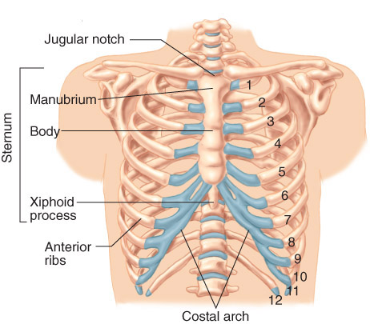
Thorax
Formed by of 12
thoracic vertebrae
and 12 pairs of ribs
Thoracic cavity
contains
  Heart
  Lungs
  Esophagus
  Great vessels

Slide 22
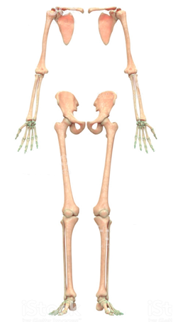
The Appendicular Skeleton
Arms, legs, their connection points, and pelvis
Includes:
  Upper extremity
  Pelvis
  Lower extremity

Slide 23
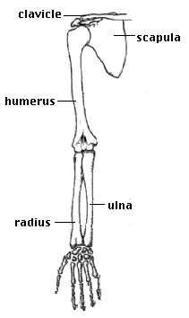
The Upper Extremity
Extends from shoulder girdle to fingertips
Composed of arms, forearms, hands, fingers
  The humerus is the supporting bone of the arm.
  The forearm consists of the radius and ulna.
    Radius on lateral side of forearm
    Ulna on medial side of forearm

Slide 24
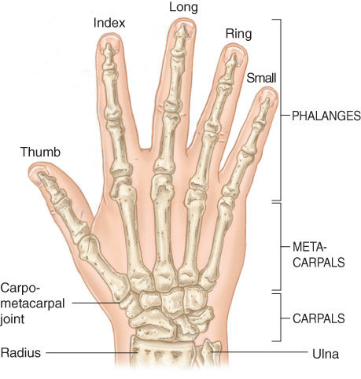
The Upper Extremity
Wrist and hand
  Ball-and-socket joint
  Principal bones
    Carpals (8)
    Metacarpals (5)
    Phalanges (14)

Slide 25
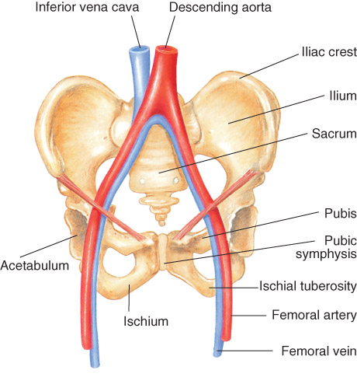
The Pelvis
Closed bony ring
consisting of three bones
  Sacrum
  Two pelvic bones
    Each pelvic bone is formed
    by fusion of ilium, ischium, and pubis.
Posteriorly, the ilium, ischium, and pubis bones are joined by the sacrum
Anteriorly, the pubic symphysis is where the right and left pubis are joined

Slide 26

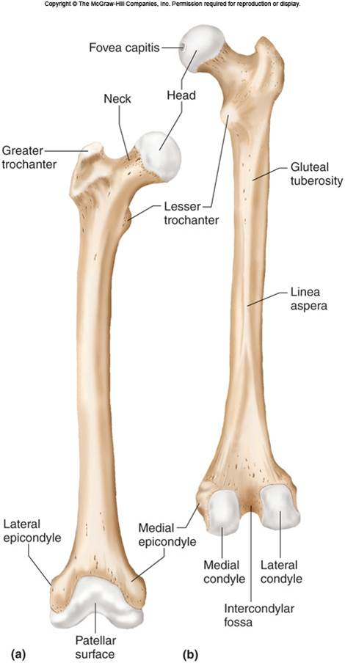
The Lower Extremity
Main parts are thigh, leg, foot.
Upper leg: femur (thigh bone)
  Longest bone in body, femur connects into acetabulum (pelvic girdle) by ball-and-socket joint.
  Greater and lesser trochanter are where major muscles of thigh connect to femur.

Slide 27
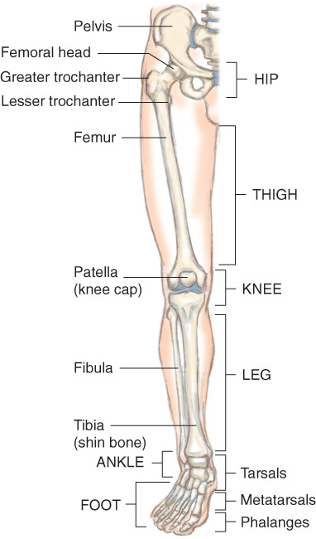
The Lower Extremity
Knee connects upper leg to lower leg
  Kneecap (patella)
Lower Leg
  Tibia (shin bone)
    Anterior of leg
  Fibula
    Lateral side of leg
Ankle
  A hinge joint Allows flexion/extension of foot

Slide 28
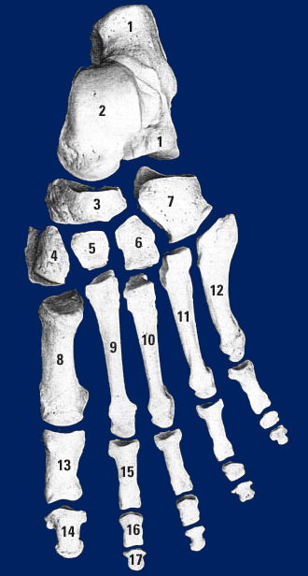
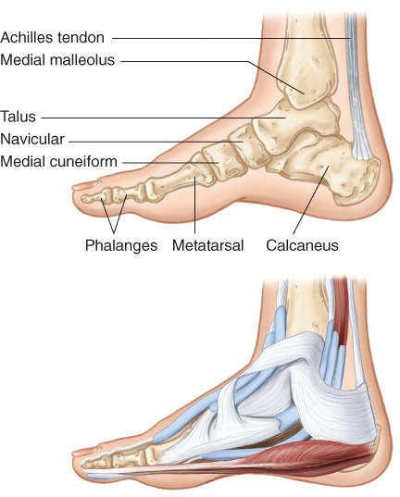
The Lower Extremity
Foot
  Tarsal bones (7)
  Metatarsal bones form substance of foot (5)
  Toes are formed by phalanges (14)

Slide 29
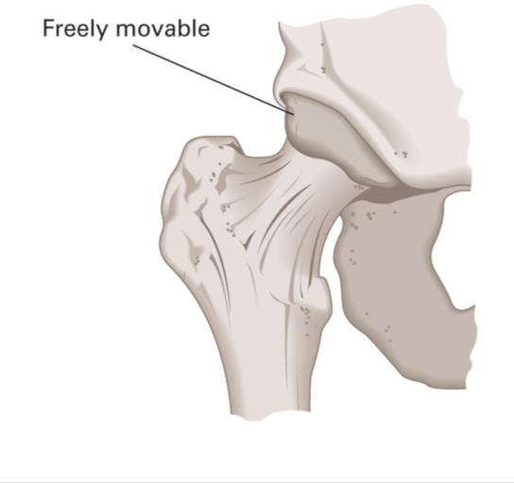
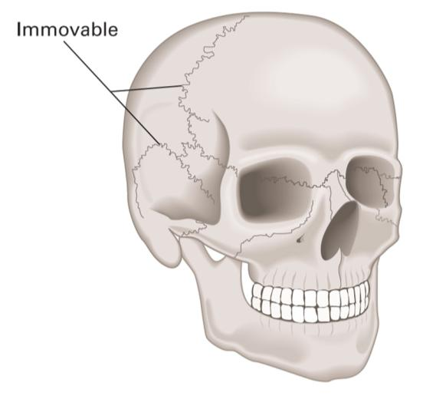
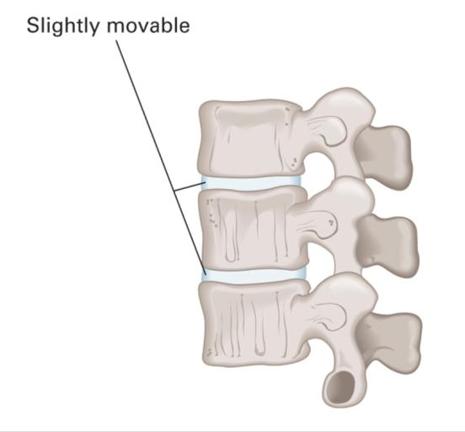
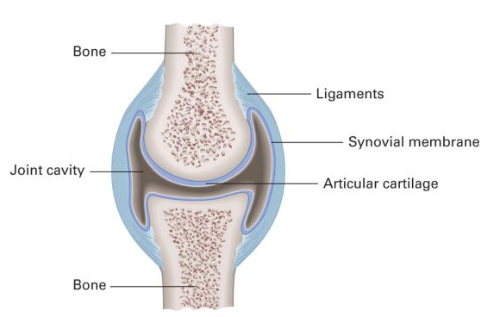
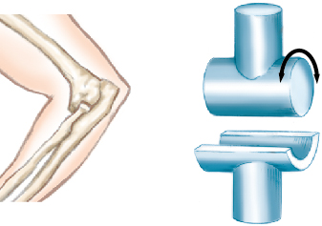
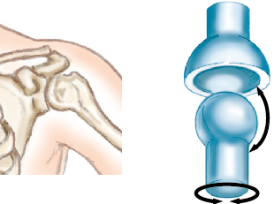
Joints
Occur wherever two bones come in contact
Freely Movable
Immovable
Slightly movable
Hinge
Ball-and-socket
© Jones and Bartlett Publishers.

Slide 30
The Musculoskeletal System: Anatomy
Musculoskeletal system provides:
  Form
  Upright posture
  Movement
More than 600 muscles attach to bone.
  Called skeletal (or voluntary) muscles

Slide 31
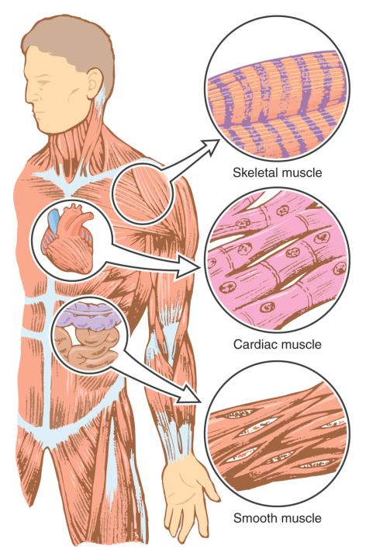

The Musculoskeletal System: Anatomy
Skeletal Muscle
Voluntary
Movement
Protection
Cardiac
Muscle
Specialized
Automaticity
Intolerant of blood loss
Smooth
Muscle
Involuntary
Nonstriated
Found in blood vessels
Notes:
Talking Points
Skeletal muscle is under the voluntary control of the brain and nervous system and can be contracted and relaxed by will of the individual. Skeletal muscle makes possible all deliberate movement, such as walking, chewing, swallowing, smiling, frowning, talking, or moving the eyeballs. It forms the major muscle mass of the body, and helps protect, shape, and form its walls.
Cardiac muscle is specialized in that it’s found only in the heart. It has the property of automaticity meaning that it can generate an impulse on its own, even when disconnected from the central nervous system. It has its own blood supply, furnished by the coronary artery system, and cannot tolerate interruption of the blood supply for even very short periods.
Smooth muscle carries out involuntary, automatic muscular functions of the body. For example, through rhythmic, wavelike movements, smooth muscles move blood through the veins, bile from the gallbladder, and food through the digestive tract. The individual has no direct control over this type of muscle, though it responds to stimuli such as stretching, heat, and cold. Smooth muscle appears non-striated and is found in the walls of organs, ducts, the respiratory tract, blood vessels, and the intestines and urinary system.
31

Slide 32
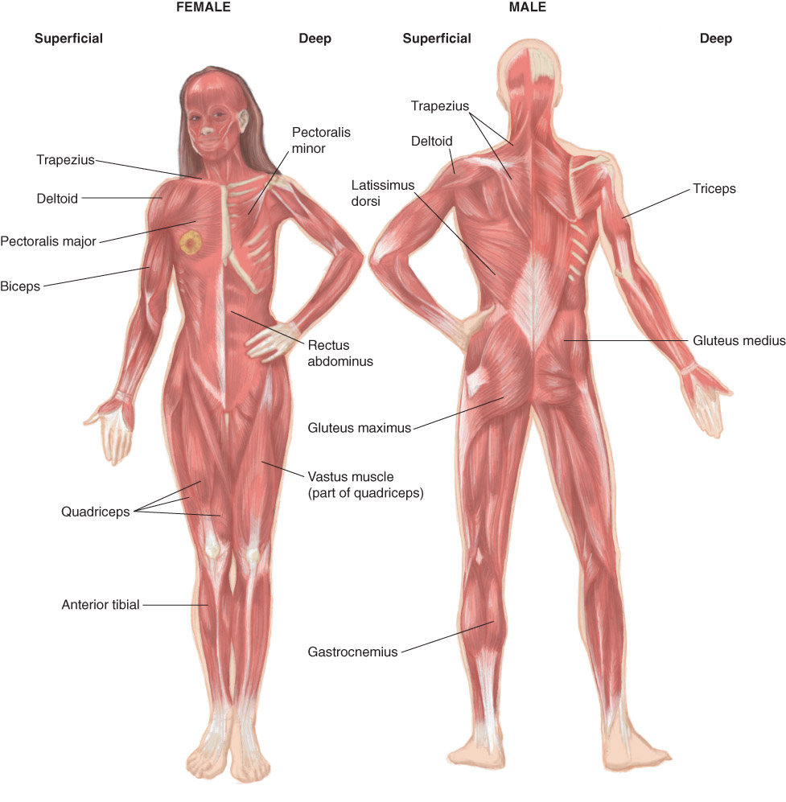
The Musculoskeletal System:
Anatomy

Slide 33
The Musculoskeletal System: Physiology
Contraction and relaxation of this system make it possible to move and manipulate the environment.
A by-product of movement is heat.
Another function of the muscles is to protect the structures under them.
Notes:
Lecture Outline
VI. The Musculoskeletal System: Physiology
A. Contraction and relaxation of the system make it possible to move and manipulate the environment.
1. A by-product of this movement is heat.
2. When you get cold, you shiver to produce heat.
B. Another function of muscles is to protect the structures under them.

Slide 34
Respiratory System
Function is to provide body with
O₂ and eliminate CO₂

Slide 35
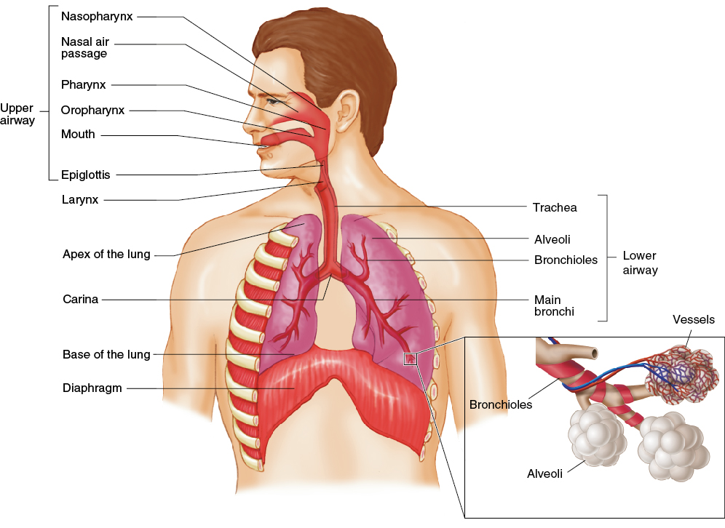
Respiratory System: Anatomy
Structures of the body that contribute to respiration (the process of breathing)
Notes:
Lecture Outline
VII. The Respiratory System: Anatomy
A. The respiratory system consists of structures of the body that contribute to the process of breathing (respiration).

Slide 36
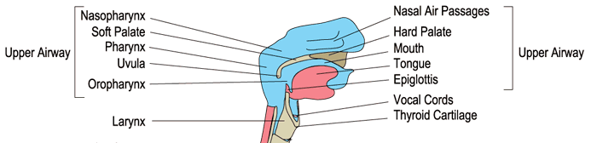
Upper Airway
Upper airway includes
  Pharynx
    Nasopharynx
    Oropharynx
    Laryngopharynx
  Epiglottis
    Prevents food and liquid from entering trachea

Slide 37
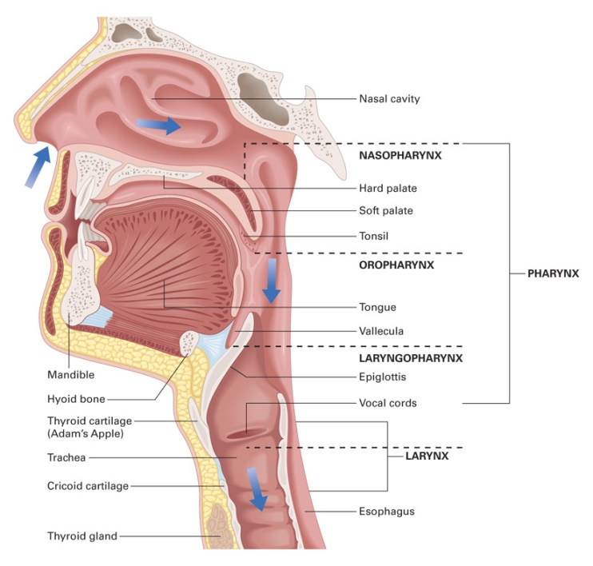
Anatomy of the Upper Airway
Upper airway consists of:
  All anatomic airway structures above the vocal cords
    Nose
    Mouth
    Jaw
    Oral cavity
    Pharynx
    Larynx
  Main function is to warm, filter,
  and humidify air as it enters
  the body.
Notes:
Lecture Outline
II. Anatomy of the Respiratory System
A. The respiratory system consists of all the structures that make up the airway and help us breathe, or ventilate.
B. The airway is divided into the upper and lower airways.
C. Anatomy of the upper airway
1. The upper airway consists of all anatomic airway structures above the vocal cords:
a. Nose
b. Mouth
c. Pharynx
d. Larynx

Slide 38
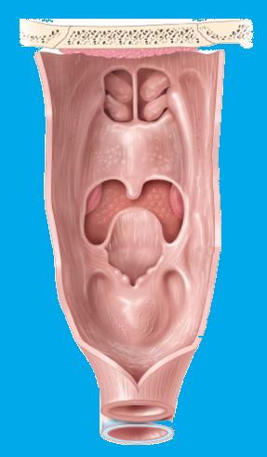
Anatomy of the Upper Airway
Pharynx
  Muscular tube extending from nose and mouth to level of esophagus and trachea
  Composed of:
    Nasopharynx
    Oropharynx
    Laryngopharynx
Nasopharynx
  Formed by the union of facial bones
  Filters out dust and small particles
  Warms and humidifies air as it enters the body
© Jones & Bartlett Learning.
Notes:
Lecture Outline
2. The main function of the upper airway is to warm, filter, and humidify air as it enters the body.
3. Pharynx
a. Muscular tube extending from the nose and mouth to the level of the esophagus and trachea
b. Composed, from top to bottom, of the nasopharynx, oropharynx, and laryngopharynx

Slide 39
Anatomy of the Upper Airway
Oropharynx
  Posterior portion of the oral cavity
  Entrance for respiratory and digestive system
  The epiglottis is superior to the larynx
      Epiglottis is closer to the head than the larynx.
Laryngopharynx
  The lower portion of the pharynx where both food and air pass. Can be found between the hyoid bone and the larynx and esophagus
© Jones & Bartlett Learning.
Notes:
Lecture Outline
2. The main function of the upper airway is to warm, filter, and humidify air as it enters the body.
3. Pharynx
a. Muscular tube extending from the nose and mouth to the level of the esophagus and trachea
b. Composed, from top to bottom, of the nasopharynx, oropharynx, and laryngopharynx

Slide 40
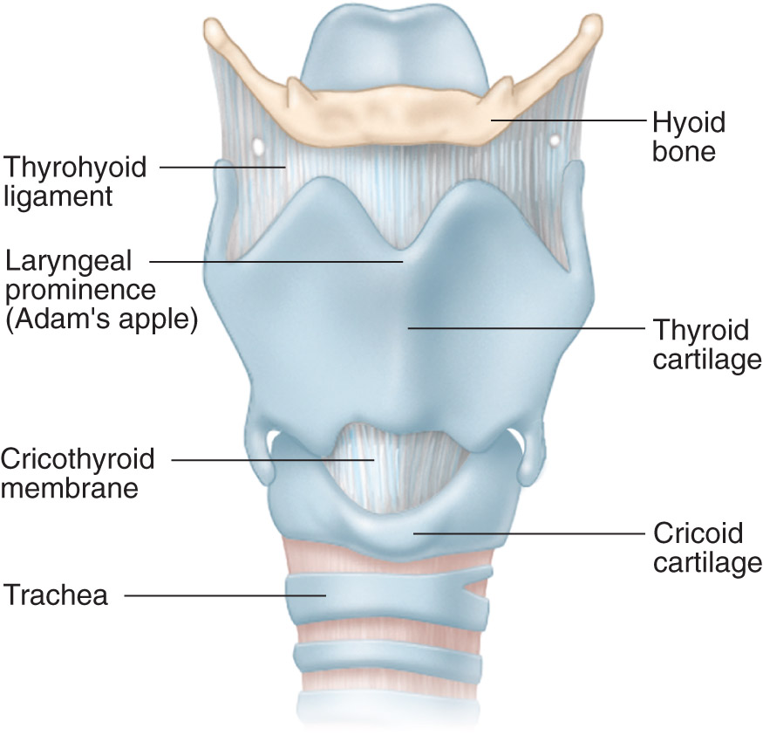
Anatomy of the Upper Airway
Larynx
  Many independent cartilaginous structures
  End of upper airway; start of lower airway
  Thyroid cartilage forms a “V” shape anteriorly.
  Cricoid cartilage: lowest portion of the larynx.
  Glottis: area between the vocal cords.
© Jones & Bartlett Learning.
Notes:
Lecture Outline
6. Larynx
a. Complex structure formed by many independent cartilaginous structures
b. Marks where upper airway ends and lower airway begins

Slide 41
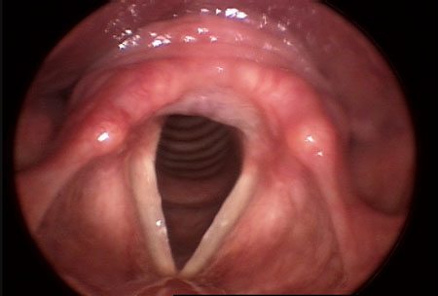
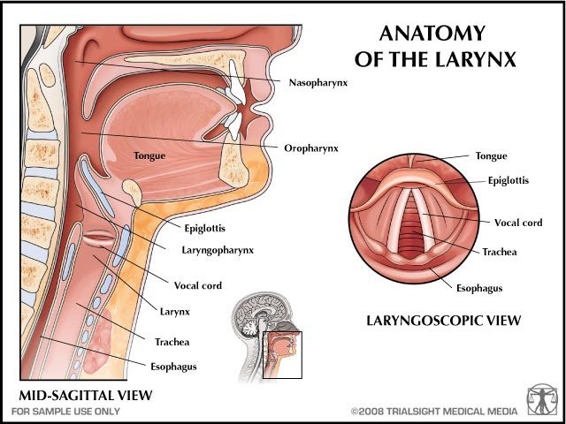
Larynx

Slide 42
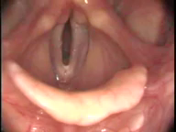
Vocal Cords

Slide 43
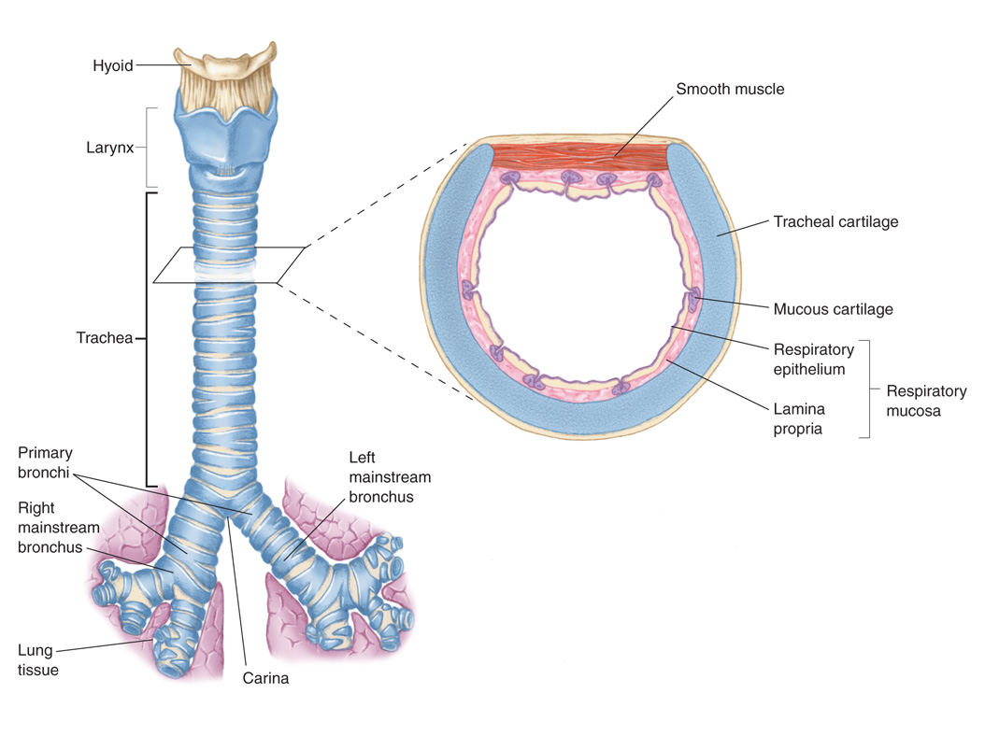
Anatomy of the Lower Airway
The function of the lower airway is to deliver oxygen to the alveoli.
Includes:
  Trachea
  Bronchi
  Lungs
Notes:
Lecture Outline
D. Anatomy of the lower airway
1. The function of the lower airway is to deliver oxygen to the alveoli.

Slide 44


Anatomy of the Lower Airway
Location of all Air Exchange
Surfactant keeps alveoli open and assists diffusion
© Jones & Bartlett Learning.
Notes:
The figure on this slide shows the trachea and lungs in the lower airway.

Slide 45


Lower Airway
Notes:
Talking Points
Bronchi are the two distal portions of the trachea branching into each lung.
Bronchioles are smaller and smaller subdivisions of bronchi. They are lined with smooth muscle and have the ability to constrict or dilate to certain stimuli.
Bronchoconstriction: smooth muscle contraction decreases the diameter of the bronchiole and increased resistance makes it more difficult to move air.
Bronchodilation: smooth muscle relaxation increases the diameter of the bronchiole and decreased resistance makes it easier to move air.
Alveoli are the thousands of tiny air sacs at the terminal end of the bronchioles. Each is enclosed in a network of capillaries and serves as the site of gas exchange in the lungs.
The lungs are two large, lobed organs that house the tiny alveolar sacs responsible for the exchange of oxygen and carbon dioxide.
The visceral pleura covers the outer surface of the lungs and the parietal pleura lines the internal chest wall. The pleural cavity is the “potential space” between these layers. Negative pressure here keeps the lungs inflated.
The diaphragm is a powerful, dome-shaped muscle essential to breathing.
The mediastinum contains all of the chest organs except the lungs.
45

Slide 46


If a break occurs in the continuity of either the parietal pleura from an open wound to the thorax or to the visceral pleura from an injury to the lung tissue, the negative pressure will draw air into the pleural space.
Notes:
Talking Points
The pleural space (space between the pleura) maintains a negative pressure.
If a break occurs in the continuity of either the parietal pleura from an open wound to the thorax or to the visceral pleura from an injury to the lung tissue, the negative pressure will draw air into the pleural space.
With each inhalation, the thorax increases its size and the pleural pressure becomes more negative.
This draws even more air into the pleural space, increasing its volume and collapsing the lung.
Lung collapse severely interferes with the ability of the alveoli to fill with air and to create an interface with the pulmonary capillaries, reducing gas exchange with the blood and leading to hypoxia.
This is why occluding any open wound to the chest is done very early in the primary assessment of a patient.
46

Slide 47


Diffusion
The passive process in which molecules move from an area with a higher concentration to an area of lower concentration.
Notes:
Lecture Outline
1. Respiration
a. Respiration: the exchange of oxygen and carbon dioxide in the alveoli and in tissues of the body
b. Diffusion: the passive process in which oxygen molecules move from an area with a higher concentration of oxygen molecules to an area of lower concentration.
c. The brain stem automatically controls breathing if the level of carbon dioxide or oxygen in arterial blood is too high or too low.
i. The medulla initiates the ventilation cycle when stimulated by high carbon dioxide levels.

Slide 48
The Respiratory System: Physiology
Hypercapnic drive (hypercarbic) (Normal)
  CO₂ level in arterial blood is impetus to breathe
Hypoxic drive (Backup system)
  O₂ levels become the impetus to breathe
  May occur in COPD patients

Slide 49
The Respiratory System: Physiology
Ventilation: Movement of air in and out of lungs
Respiration: Exchange of O₂ and CO₂ in alveoli and tissue.
Tidal volume: Amount of air moved in or out of lungs in 1 breath. (~ 500ml)
Residual volume:(air always in the lungs)
Dead space: (air in the "piping")
Minute volume: (Tidal volume x Frequency)
Notes:
Lecture Outline
2. Ventilation
a. Ventilation: simple movement of air into and out of the lungs
b. Tidal volume: the amount of air that is moved into or out of the lungs during a single breath
c. Residual volume: the gas that remains in the lungs to keep the lungs open
d. Minute volume: the amount of air that moves in and out of the lungs in 1 minute minus the dead space
e. Respiratory rate × tidal volume = minute volume

Slide 50
Characteristics of Normal Breathing
Normal rate and depth (tidal volume)
Regular rhythm or pattern of inhalation and exhalation
Clear, audible breath sounds on both sides of chest
Regular rise and fall movement on both sides of the chest
Movement of the abdomen
Notes:
Lecture Outline
C. Normal breathing
1. Normal rate and depth (tidal volume)
2. Regular rhythm or pattern of inhalation and exhalation
3. Clear, audible breath sounds on both sides of chest
4. Regular rise and fall movement on both sides of the chest
5. Movement of the abdomen

Slide 51
Inadequate Breathing
Patterns in Adults
Labored breathing
Muscle retractions
Pale, cyanotic, cool, damp skin
Tripod position
Agonal gasps (gasping breaths)
Nasal Flaring
Irregular Rhythm
Unusual Sounds on auscultation
Altered Mental Status
Notes:
Lecture Outline
D. Inadequate breathing patterns
1. Labored breathing
2. Muscle retractions above the clavicles, between the ribs, and below the rib cage
3. Pale or cyanotic (blue) skin
4. Cool, damp (clammy) skin
5. Patient in the tripod position (leaning forward on arms stretched forward)
6. Agonal gasps

Slide 52
Circulatory System

Slide 53

The Circulatory System: Anatomy
Notes:
This figure shows the circulatory system.

Slide 54

Can die from losing half to two-thirds of their Blood Volume
~335 ml
~2 L
~4 L
An adult has approx. 70mL of blood per kilogram.
(1 kg equals 2.2 pounds; 1 lb is equal to ~0.45kg)
(1 L ~ 1.057 qt @200 lb ~ 90.7 kg ~6.3 L ~6.7 qt)
Notes:
Talking Points
One of the determinants of an adequate blood pressure and perfusion is blood volume.
An adult has approximately 70 mL of blood for every kilogram (2.2 lbs) of body weight. Thus, a patient who weighs 154 lbs or 70 kg would have approximately 4,900 mL or 4.9 liters of blood volume.
Blood volume correlates with body mass; therefore, a larger patient would normally have a greater blood volume.
The loss of one liter of blood in a 100-pound patient would be much more significant than in a 200-pound patient.
54

Slide 55
The Heart
Hollow muscular organ the size of an adult’s clenched fist
Made of specialized cardiac muscle (myocardium)
Works as two paired pumps
  Septum divides right and left sides.
Each side is divided into:
  Atrium (upper chamber)
  Ventricle (lower chamber)

Slide 56
The Heart
Normal adult resting heart rate (HR):
  60–100 beats/min
Stroke volume (SV)
  Amount of blood moved by one beat
Cardiac output (CO)
  Amount of blood moved in 1 minute
  HR × SV = CO
Notes:
Lecture Outline
5. Normal heart rate (HR)
a. Normal pulse rate for an adult: 60–100 beats/min
b. Stroke volume (SV): the amount of blood moved by one beat
c. Cardiac output (CO): the amount of blood moved in 1 minute
i. CO = HR × SV

Slide 57
The Heart
In 1 minute, body’s entire blood volume
(5 to 6 L) is circulated through all the vessels.
Electrical conduction system
  Causes smooth, coordinated contractions
  Contractions produce the pumping action
Notes:
Lecture Outline
6. Electrical conduction system
a. A network of specialized tissue that is capable of initiating and conducting electrical current runs throughout the heart.
b. Electrical impulses begin high in the atria at the sinoatrial (SA) node, travel to the atrioventricular (AV) node and bundle of His, and then move through the Purkinje fibers to the ventricles.
c. This movement produces a smooth flow of electricity, producing a coordinated pumping action.

Slide 58

Vessels
Arteries
  Carry blood away from the
  heart .
  Ascending /descending aorta
Veins
  Return blood to the heart
  Superior vena cava / Inferior
  vena cava
Capillaries
  Connect arterioles to venules
  Allow contact between blood and cells

Slide 59

Blood Flow
Arteries
Arterioles
Capillaries
Venules
Veins

Slide 60
Nervous System

Slide 61

The Nervous System: Anatomy and Physiology
The nervous system is perhaps the most complex organ in body
Divided into two main portions:
  Central nervous system (CNS)
  Peripheral nervous system
The Central Nervous System consists of:
  Brain
  Spinal cord

Slide 62


Central Nervous System The Brain
Cerebrum:
  Initiates and manages motions under conscious control
  Occupies nearly all of the cranial cavity.
  Controls specific body functions
Cerebellum:
  Coordinates muscle activity
  and maintains balance.
Brainstem:
  Consists of the midbrain,
  pons, and medulla oblongata.
  Controls critical functions like
  the respiration, heart rate and blood pressure.
Notes:
– The cerebrum is the outermost portion of the brain and occupies nearly all the cranial cavity. It controls specific body functions, such as sensation, thought, and associative memory. It also initiates and manages motions that are under the conscious control of the individual.
– The cerebellum coordinates muscle activity and maintains balance through impulses from the eyes and the ears. Though it cannot initiate a muscle contraction, it can hold muscles in a state of partial contraction.
– The brainstem consists of the midbrain, pons, and medulla oblongata. It controls critical functions like the respiration, heart rate and blood pressure.

Slide 63

Central Nervous System
Spinal cord
  Continuation of the brain
  Transmits messages between brain and body

Slide 64
Peripheral Nervous System
Two types of nerves within peripheral nervous system
  Sensory nerves carry information from body to CNS.
  Motor nerves carry information from CNS to muscles.

Slide 65
Skin:
The Integumentary System
Two layers
  Epidermis (superficial)
  Dermis (deeper)
Below the skin lies subcutaneous tissue.
  Fat that insulates and serves as energy reservoir
Notes:
Lecture Outline
XII. The Integumentary System (Skin): Anatomy
A. Two layers of skin
1. Epidermis (superficial)
a. Composed of several layers of cells
i. Germinal layer: produces new cells
ii. Stratum corneal layer: surface layer of dead cells
iii. Skin cells are constantly being replaced.
2. Dermis (deeper)
a. Contains special structures of the skin
i. Sweat glands
ii. Sebaceous glands
iii. Hair follicles
iv. Blood vessels
v. Mucous membranes
B. Below the skin lies subcutaneous tissue, a layer of fat that serves as an insulator and as an energy reservoir.

Slide 66
The Integumentary System (Skin): Anatomy
Epidermis: Top layer (.05-1.5 mm)
    Does not contain blood vessels
    Skin color comes from a pigment - melanin - found in the deepest layers of the epidermis.
Dermis: Second layer (.3-3 mm)
    Many blood vessels
    Sensory Nerves – Touch/Cold/Heat/Pain
    Hair follicles
    Sweat glands/Oil Glands
Subcutaneous Layers
    Larger Blood vessels and Nerves
    Fat - Provides shock absorption, insulation
Notes:
Talking Points
The skin has three layers:
– The epidermis, or outermost layer of skin, is composed of four layers of cells. The outer two layers are dying and dead cells that are sloughed off as new cells replace them. Skin color comes from a pigment called melanin that is found in the deepest layers of the epidermis.
– The dermis, or second layer of the skin, is much thicker than the epidermis and contains a vast network of blood vessels that supply the skin, hair follicles, sweat glands, oil glands, and sensory nerves. It is dense connective tissue and gives the skin its elasticity and strength.
– The subcutaneous layer is mostly fatty tissue that varies in thickness depending on what part of the body it covers.
In addition to the layers of skin, there are numerous accessory structures, also known as appendages. These are the nails, hair, sweat glands, oil glands, and sensory receptors.

Slide 67

The Integumentary System (Skin): Anatomy
© Jones and Bartlett Publishers.
Notes:
This figure shows the layers of the skin.

Slide 68
The Integumentary System (Skin): Physiology
The skin is the largest single organ in the body.
Three major functions
  Protect the body in the environment
  Regulate body temperature
  Transmit information from environment to brain
Notes:
Lecture Outline
XIII. The Integumentary System (Skin): Physiology
A. The skin is the largest single organ in the body.
B. Three major functions:
1. Protect the body in the environment
2. Regulate body temperature
a. Sweat is secreted to the skin surface from the sweat glands.
3. Transmit information from the environment to the brain

Slide 69
The Digestive System: Anatomy
Function of system is digestion.
Abdomen is second major body cavity.
  Contains major organs of digestion and excretion
  Quadrants are easiest way to identify areas
    Right Upper Quadrant (RUQ)
    Left Upper Quadrant (LUQ)
    Right Lower Quadrant (RLQ)
    Left Lower Quadrant (LLQ)

Slide 70


The Digestive System: Anatomy

Slide 71

The Digestive System: Anatomy
Alimentary Tract
Mouth
  Lips, cheeks, gums, teeth, tongue
  Salivary glands
Oropharynx
Esophagus
Stomach
Pancreas
Liver
Small intestine
Large intestine
Appendix
Rectum

Slide 72

The Urinary System:
Anatomy and Physiology
Controls fluid balance in the body
Filters and eliminates wastes
Controls pH balance
Consists of:
  Kidneys
  Ureter
  Urinary bladder

Slide 73
The Genital System: Anatomy and Physiology
Controls reproductive processes
Male system consists of:
  Testicles
  Epididymis
  Vasa Deferentia
  Penis
Female system consists of:
  Ovaries
  Fallopian tubes
  Uterus
  Cervix
  Vagina

Slide 74

Male Reproductive System

Slide 75

Female Reproductive System

Slide 76


What you didn't want to ask….

Slide 77
The Lymphatic System
Supports the circulatory system and immune system
Lymph is a thin, straw-colored fluid that carries oxygen and nutrients to cells and waste products away.
Helps to rid the body of toxins and other harmful materials
Notes:
Lecture Outline
XVI. The Lymphatic System: Anatomy and Physiology
A. Composed of the spleen, lymph nodes, lymph, lymph vessels, thymus gland, and other components
B. Supports the circulatory system and immune system
C. Lymph is a thin, straw-colored fluid that carries oxygen, nutrients, and hormones to the cells and waste products of metabolism away from the cells to be excreted.
1. Lymph vessels form a network throughout the body that serves as an auxiliary to the circulatory system.
2. Lymph nodes are tiny, oval-shaped structures that filter lymph.
3. They help rid the body of toxins and other harmful materials.

Slide 78
The Endocrine System: Anatomy and Physiology
Complex message and control system
Integrates many body functions
Hormones are released directly into the bloodstream.
Each hormone has a specific effect on some organ, tissue, or process.
Notes:
Lecture Outline
XVII. The Endocrine System: Anatomy and Physiology
A. The endocrine system is a complex message and control system that integrates many body functions.
B. Endocrine glands release hormones directly into the bloodstream.
1. Each endocrine gland produces one or more hormones.
2. Each hormone has a specific effect on some organ, tissue, or process.

Slide 79

The Endocrine System:
Anatomy and Physiology
Complex message and control system
Integrates many body functions
Hormones are released directly into bloodstream.
  Examples: epinephrine, norepinephrine, insulin
Controls release of hormones in the body

Slide 80
Life Support Chain
All cells in body require oxygen, nutrients, and removal of waste.
The respiratory and circulatory systems are the carriers of these supplies and wastes.
If interference occurs, cells become damaged and die.
Notes:
Lecture Outline
XX. Life Support Chain
A. Cells are the foundation of the human body.
1. All cells in the body require oxygen, nutrients, and removal of waste.
2. The respiratory and circulatory systems are the carriers of these supplies and wastes.
3. If interference occurs, cells become damaged and die.

Slide 81
Life Support Chain
Cells use oxygen to turn nutrients into chemical energy through metabolism.
  Adenosine triphosphate (ATP) is used to store energy.
Aerobic metabolism uses oxygen.
Cells switch to anaerobic metabolism when oxygen is limited.
Anaerobic metabolism: Body creates energy through the combustion of Gloucose in the ABSENCE of oxygen. Produces lactic acid as a byproduct. Lactic acid builds up leads to fatigue and more ….
Aerobic metabolism: Body creates energy through the combustion of carbohydrates, amino acids, and fats in the presence of oxygen. Produces heat, water and carbon dioxide as byproducts.
Notes:
Lecture Outline
B. Cells use oxygen to take available nutrients and turn them into chemical energy through metabolism.
1. Adenosine triphosphate (ATP) is used to store energy.
2. Aerobic metabolism uses oxygen.
3. Cells switch to anaerobic metabolism when oxygen is limited.
4. Movement of oxygen, waste, and nutrients occurs by diffusion.

Slide 82
Pathophysiology
The study of functional changes that occur when the body reacts to disease
Notes:
Lecture Outline
XXI. Pathophysiology
A. Pathophysiology is the study of functional changes that occur when the body reacts to disease.
B. Respiratory compromise is the inability to move gas effectively.
1. Can lead to:
a. Hypoxia: decreased level of oxygen in the body
b. Hypercarbia: elevated level of carbon dioxide in the body

Slide 83
Pathophysiology
Respiratory compromise can lead to:
  Hypoxia
  Hypercarbia
Notes:
Lecture Outline
3. Factors that impair respiration:
a. Change in the atmosphere
b. High altitudes
c. Impaired movement of the gas across the cell membrane

Slide 84
Pathophysiology
Factors that impair Ventilation:
  Blocked airway
  Impairment of the muscles of breathing
  Physiologic obstruction of the airway (asthma)
Factors that impair Respiration:
  Change in atmosphere
  High altitudes
  Impaired movement of the gas across the cell membrane
Notes:
Lecture Outline
2. Factors that impair ventilation:
a. Blocked airway
b. Impairment of the muscles of breathing
c. Physiologic obstruction of the airway (eg, asthma attack)
d. Numerous other factors

Slide 85
Pathophysiology
Effects of respiratory compromise on the body:
  Oxygen levels fall and carbon dioxide levels rise.
  Respiratory rate increases.
  Blood becomes more acidic.
  The brain sends commands to the body to breathe.
Notes:
Lecture Outline
C. Effects of respiratory compromise on the body
1. Oxygen levels throughout the body fall and carbon dioxide levels rise.
2. The brain detects an increase in carbon dioxide levels.
3. The body increases its respiratory rate in an attempt to return the carbon dioxide levels to normal.
4. If increased respiratory does not occur or is not effective in returning the carbon dioxide levels to normal, the blood will become more acidic.
5. Blood oxygen levels will begin to fall, which will cause the brain to issue further commands to breathe.

Slide 86
Shock
Shock is the condition of not enough blood flow to the tissues of the body as a result of problems with the circulatory system.
  Lack of Perfusion
Categorized into several types depending on the cause
  Cardiogenic: Due to heart problems
  Hypovolemic: Caused by too little blood volume
  Anaphylactic: Caused by allergic reaction
  Septic: Due to infection
  Neurogenic: Caused by nervous system damage
Notes:
Lecture Outline
D. Shock
1. A condition in which organs and tissue receive an inadequate flow of blood and oxygen
2. Impaired oxygen delivery causes cellular hypoxia, which leads to anaerobic metabolism, lactic acid production, and organ dysfunction.
3. Shock is categorized into several types depending on the cause.

Slide 87
Shock
Effects of shock on the body:
  Level of oxygen supplied to tissues falls
  Cells engage in anaerobic metabolism
  Severe metabolic acidosis ensues
  Baroreceptors initiate release of epinephrine and norepinephrine
  Heart rate increases
  Interstitial fluid moves into the capillaries
Notes:
Lecture Outline
E. The effects of shock on the body are similar to those of respiratory compromise.
1. The level of oxygen supplied to the tissues falls.
2. Cells engage in anaerobic metabolism, resulting in lactic acid production.
3. Severe metabolic acidosis ensues, leading to increased levels of carbon dioxide within the blood.
4. Baroreceptors detect decreased blood pressure and initiate the release of epinephrine and norepinephrine.
5. The heart rate increases, the heart beats more forcefully, and blood vessels constrict.
6. Interstitial fluid moves into the capillaries.

Slide 88
Impairment of Cellular Metabolism
Results in the inability to properly use oxygen and glucose at the cellular level
Cells create energy through anaerobic (low oxygen) metabolism.
Can result in metabolic acidosis
Brain cells cannot use alternative fuels.
Cellular injury may become irreversible.
Notes:
Lecture Outline
F. Impairment of cellular metabolism results in the inability to properly use oxygen and glucose at the cellular level.
1. When there is inadequate oxygen, cells will create energy through anaerobic metabolism.
a. Can result in metabolic acidosis
b. Requires more energy than when using glucose for fuel
c. Decreases the blood’s ability to effectively carry oxygen to the cells
d. Decreases the functioning of oxygen within the cell
e. Brain cells cannot use alternative fuels.
i. If their supply of glucose decreases dramatically, brain cells will quickly become damaged or die.
f. Cellular injury, up to a point, may be repairable if normal tissue perfusion is restored.

